Slide 1

Don’t Just PDF, “Smart” PDF!

Slide 2

Who am I
Shirak Avakian
Enterprise Solution Architect
QBI LLC
I code too
shirakavakian@gmail.com
@shirakavakian

Slide 3

Definitions & Facts
What is a PDF?
Portable Document Format (PDF) is a file format used
to present and exchange documents reliably,
independent of software, hardware, or operating
system.
Some Facts About a PDF
Invented by Adobe.
Open standard maintained by ISO ( International Standards Organization).
Can contain links and buttons, form fields,
audio, video, and business logic.
Can also be signed electronically

Slide 4
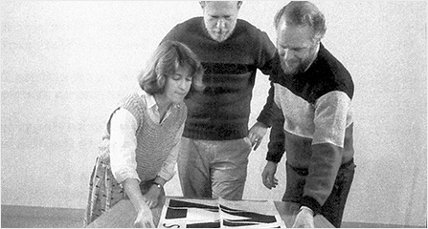
History
In 1991, Adobe cofounder Dr. John Warnock launched the paper-to-digital revolution with an idea he called The Camelot Project.
By 1992, Camelot had developed into PDF. Today, it is the format trusted by businesses around the world.
Today, Warnock's vision is alive, well, and evolving. Adobe PDFs preserve all the data in the original file - even when text, graphics, spreadsheets, and more.

Slide 5

Security
Secure a PDF by
Password
Redacting sensitive information
Sanitization—Remove hidden data from a PDF
Digital signature using a private/public key pair

Slide 6
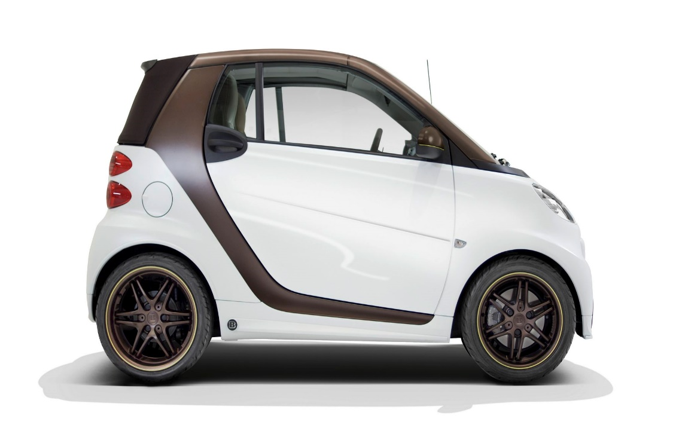

Conclusion
If you can share & reduce physical occupation of 1000 books to 1000 digital files resting in your lap.
If you can search for files, pages within seconds.
If you can sign, edit, comment, stamp a PDF.
If you can secure a PDF.
If all above can be done by a PDF, shouldn’t we call it SMART?

Slide 7
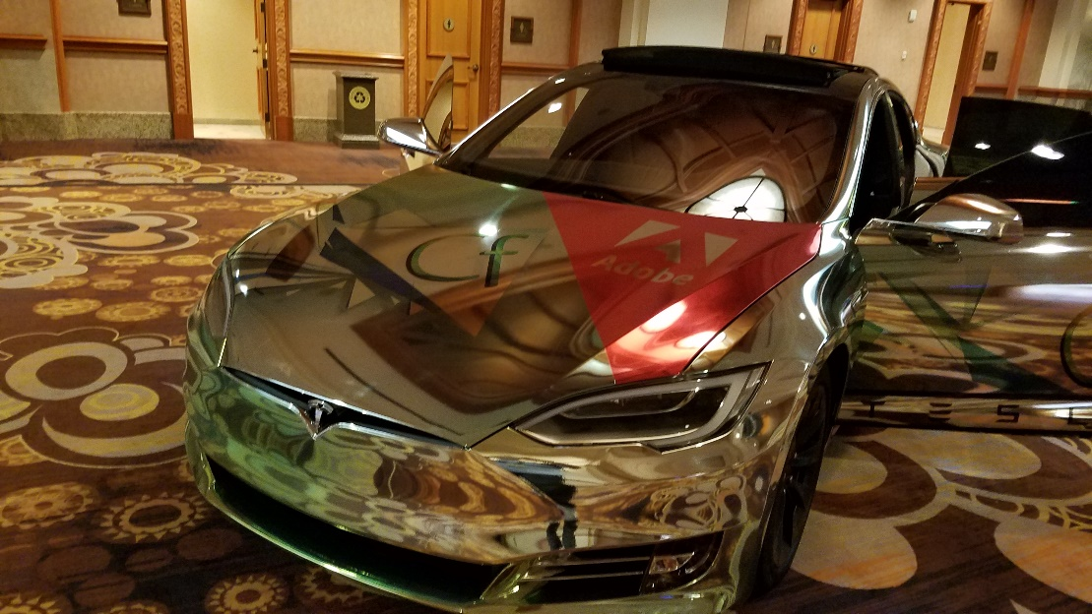
Not yet, until we make it smarter by predefining the workflow
Custom Properties.
Exporting and importing metadata.
Sanitization.
Barcode.
All together to create a PDF workflow.

Slide 8
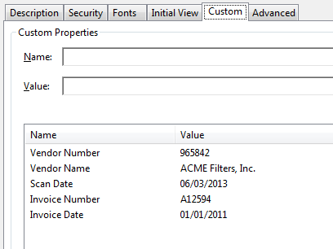
PDF Custom Properties
Ability to add custom properties to store specific data.
ColdFusion can only read custom properties as of 2016 release.
To create custom properties we will use JAVA.
No need to load extra library, ColdFusion already has iText java library pre-loaded.

Slide 9
DEMO 1
Demo-CustomProperty

Slide 10
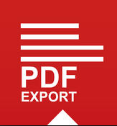

Exporting & Importing Metadata
Metadata Includes information about the document and its contents, such as the author’s name, keywords, and copyright information, that can be used by search utilities.
XMP The Extensible Metadata Platform (XMP) provides Adobe applications with a common XML framework that standardizes the creation, processing, and interchange of document metadata across publishing workflows.

Slide 11
Exporting & Importing Metadata
Export Specify the source of the PDF and destination of the XMP file.
<cfpdf action=“export” type=“metadata” source = “file.pdf” exportTo =“file.xmp”/>
Import Specify the source of the PDF, the source of XMP file and the destination for the file to be placed.
<cfpdf action=“import” type=“metadata” source=“file.pdf” importFrom=“file.xmp” destination=“PDF output file pathname” /or name=“PDF document variable name”/>

Slide 12
DEMO 2
Demo-Export-Import

Slide 13
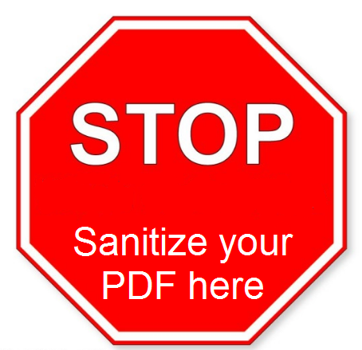
Sanitization
Sanitize Removes metadata from your PDF document so that sensitive information is not passed along when you publish your PDF.
Sanitize removes the following:
Metadata
Attached files
Scripts
Search indexes
Form data
Review and comment data
Obscured text and images
Unreferenced data
Links
Actions and javascripts
Overlapping objects

Slide 14
DEMO 3
Demo-Sanitize

Slide 15
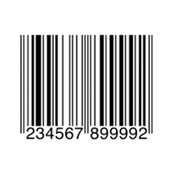
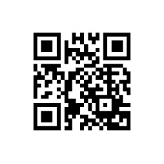
Barcode
A barcode is an optical, machine-readable, representation of data; the data usually describes something about the object that carries the barcode. (Wikipedia)
One-Dimensional (1D) Barcode
Systematically represent data by varying the widths and spacings of parallel lines, and may be referred to as linear or one-dimensional.
Two-Dimensional (2D) Barcode
Systematically represent data using two-dimensional symbols and shapes. They are similar to a linear 1D barcode, but can represent more data per unit area.

Slide 16
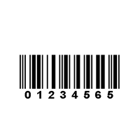
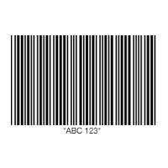
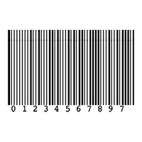
Barcode-1D Types
One-Dimensional (1D) Barcode Types
UPC CODE
EAN CODE
CODE 39
CODE 128
ITF (Interleaved 2 OF 5)
CODE 93
CODABAR
GS1 DATABAR
MSI PLESSEY
UPC CODE
ITF (Interleaved 2 OF 5)
CODE 39
MSI PLESSEY

Slide 17
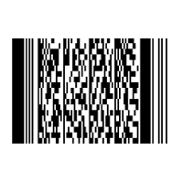
Barcode-2D Types
Two-Dimensional (2D) Barcode
QR Code
Used in tracking and marketing. Free to use, flexible in size, has a high fault tolerance, and fast readability. However, it can’t be read with a laser scanner. It supports four different modes of data: numeric, alphanumeric, byte/binary, and Kanji. It is a public domain and free to use.
PDF417
Used in applications that require the storage of huge amounts of data, such as photographs, fingerprints, signatures, text, numbers, and graphics.
It can hold over 1.1 kilobytes of machine-readable data, making it more powerful than other 2D barcodes. Like QR codes, PDF417 barcodes are public domain and free to use.
DATAMATRIX CODE
AZTEC

Slide 18
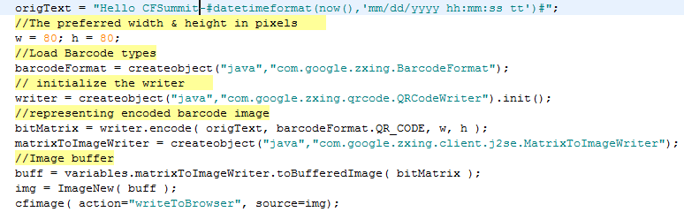
Barcode-2D-QR
How to generate/read QR Barcode
Download ZXing ("zebra crossing") is an open-source, multi-format 1D/2D barcode image processing library implemented in Java. https://github.com/zxing/zxing
Save the library in your ColdFusion class path C:\{cfserverhome}\{cfusion}\wwwroot\WEB-INF\lib
Restart ColdFusion server

Slide 19
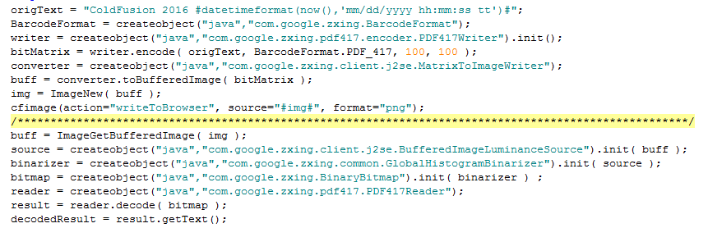
Barcode-2D-PDF417
How to generate PDF417 Barcode

Slide 20
DEMO 4
Demo-Barcode

Slide 21
Real case scenario
Custom properties
Export XMP
barcode
sanitize
send
receive
Read barcode
Import XMP
Continue next action

Slide 22
Real case scenario
Custom Properties
Export XMP (The Metadata)
Export the metadata (XMP) file to folder structure by making the file name same as tracking number
D:\DMS\xmp\{trackingNumber}.xmp
Key pair value( TrackingNumber, WorkflowID)
TrackingNumber: unique ID (CreateUUID) to validate the PDF by embedding inside the barcode.
WorkflowID: unique ID (Database ID)definition to tell the PDF what to do next

Slide 23
DEMO 5
Demo-Vote Registration

Slide 24
Thank you
Questions
Resources
Don’t leave hold of your common sense. Think about what you’re doing and how the technology can enhance it.
Don’t think about technology first.
(Esther Dyson)
https://acrobat.adobe.com
http://www.scandit.com/
http://developers.itextpdf.com
Source Code https://github.com/cfclick/CFSummit2016

